Slide 1
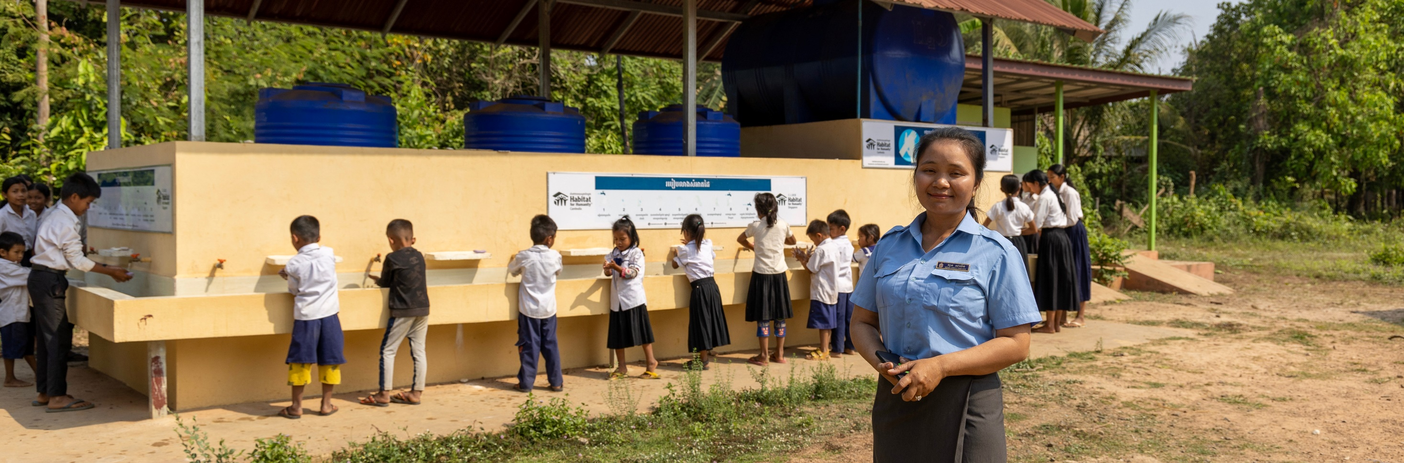
upper Primary
Subsidiarity and Participation
Notes:
Salin stands in front of school children in Cambodia who are all lined up accessing safe and clean water. Photo: Caritas Australia

Slide 2
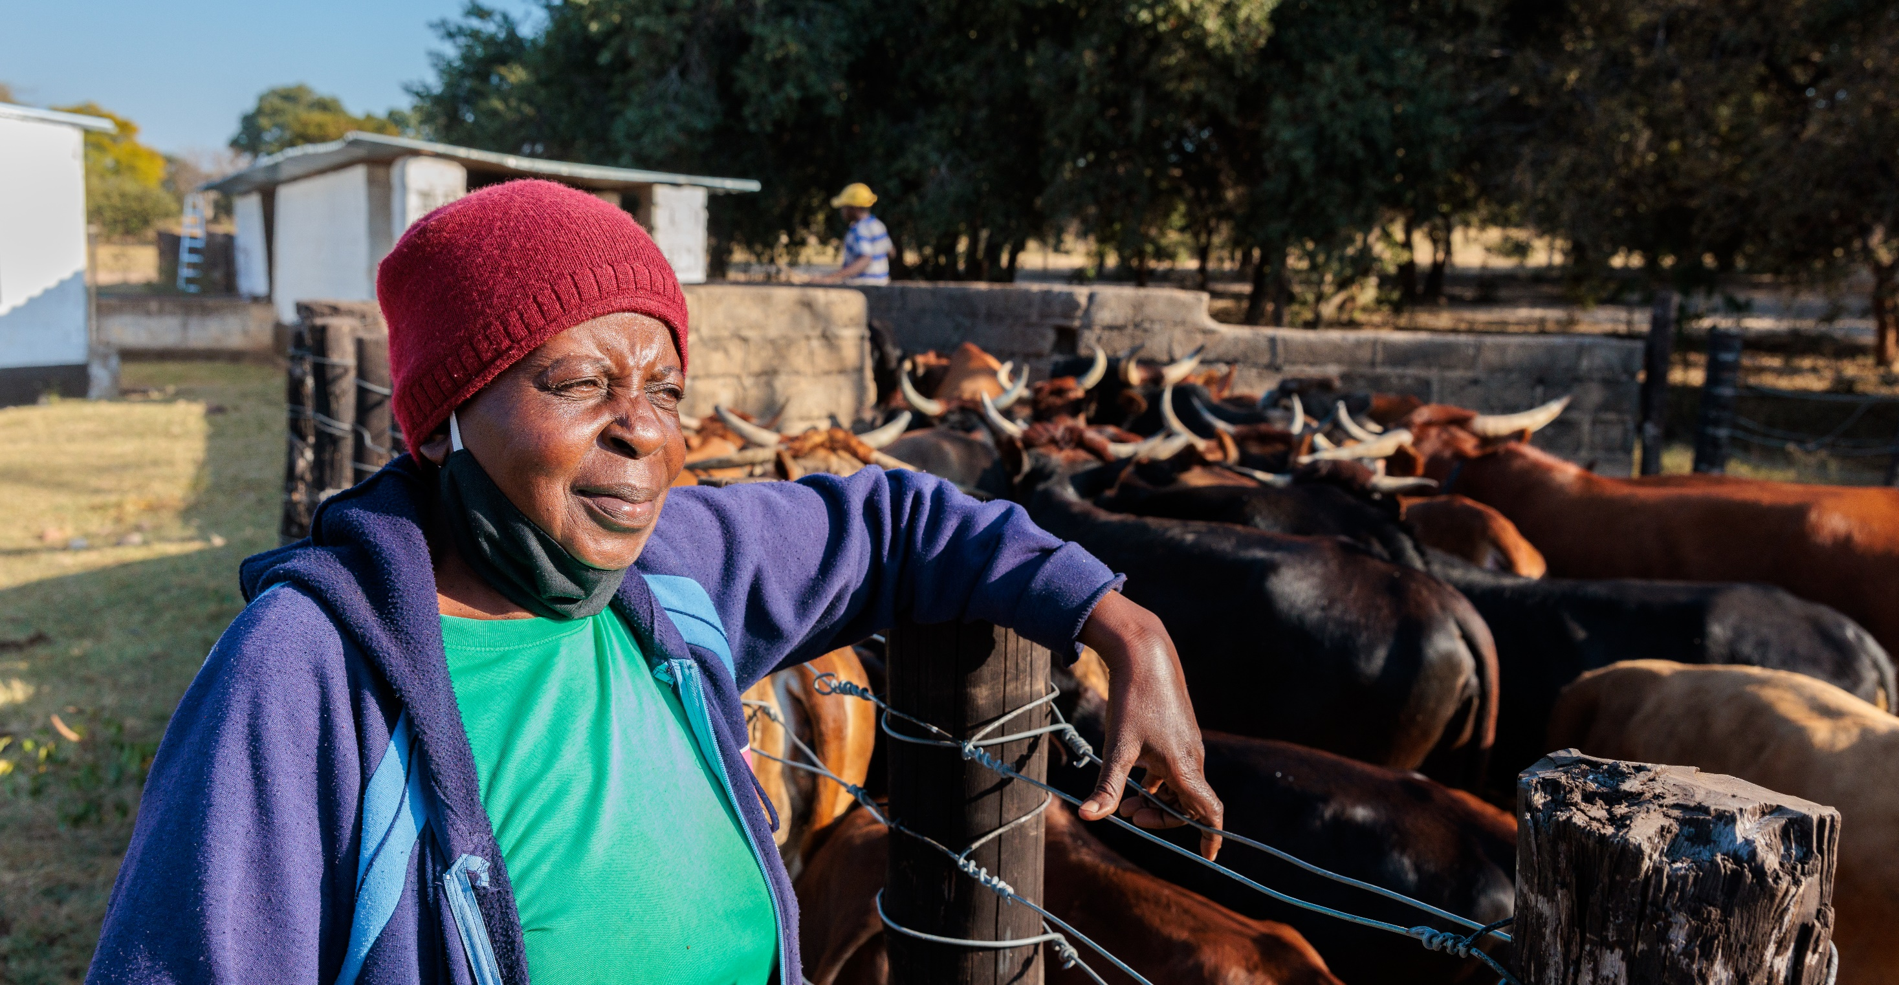
‘When a project is launched that directly or indirectly touches certain social groups, these groups cannot be left out from participating … The first step is to allow [people] to tell you how they live, what they need: Let everyone speak! … We cannot leave the people out of participation; their wisdom, the wisdom of the humbler groups cannot be set aside.’
Pope Francis, General Audience 23rd September 2020.
Photo: Richard Wainright/Caritas Australia
Notes:
Photo: Priscilla watches her cattle enter the dip tank near her home in Hwange district, north-western Zimbabwe. Priscilla has spent time learning conservation farming techniques to grow drought-resistant crops to help mitigate the effects of climate change.

Slide 3
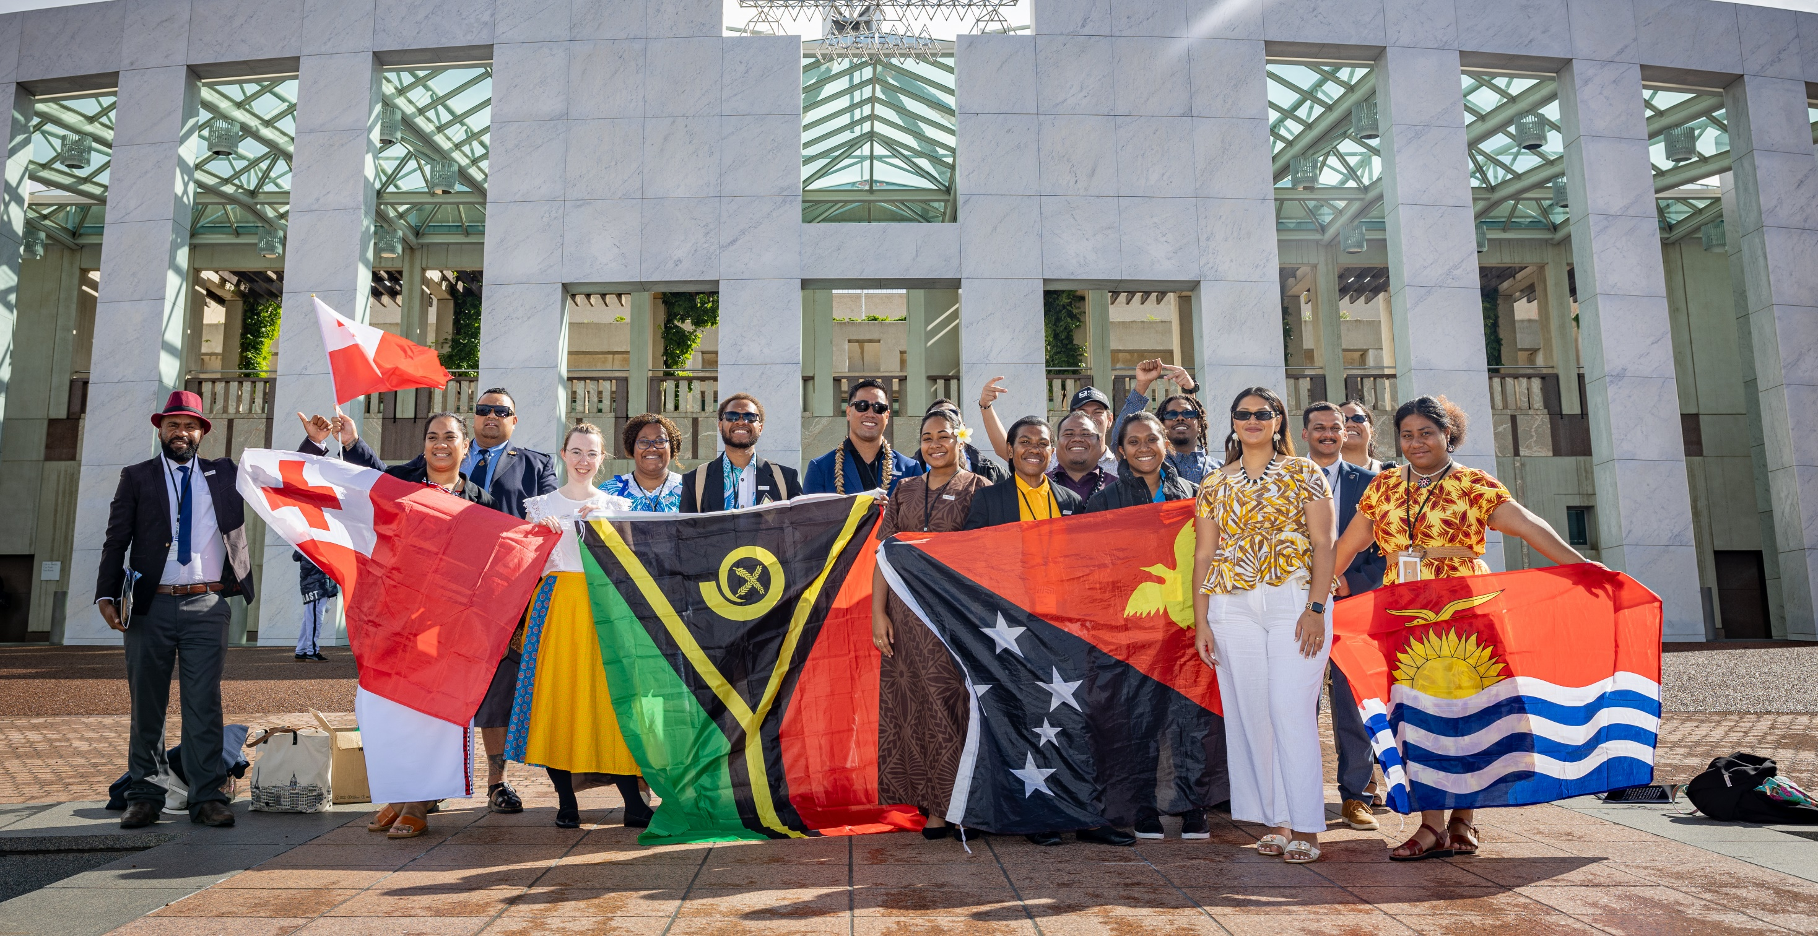
Continuum Statements
Photo: Caritas Australia
Notes:
Delegates from the Pacific Australia Emerging Leaders network gather outside Parliament House, Canberra.

Slide 4
Decision makers should visit communities and listen to the people who are most affected by a problem

Slide 5
Decision makers should stay in their office and make decisions without talking to anyone

Slide 6
Decision makers should do whatever is easiest

Slide 7
Decision makers should only listen to the people who are the loudest

Slide 8
When I am asked to help out in the community, I should just let the leaders or decision makers do it.

Slide 9
When I am asked what I think about a decision, I should think carefully and give my perspective.

Slide 10
When I am asked what I think about a decision, I should think carefully for my family and myself, but also for those who are less privileged than I am.

