Slide 1
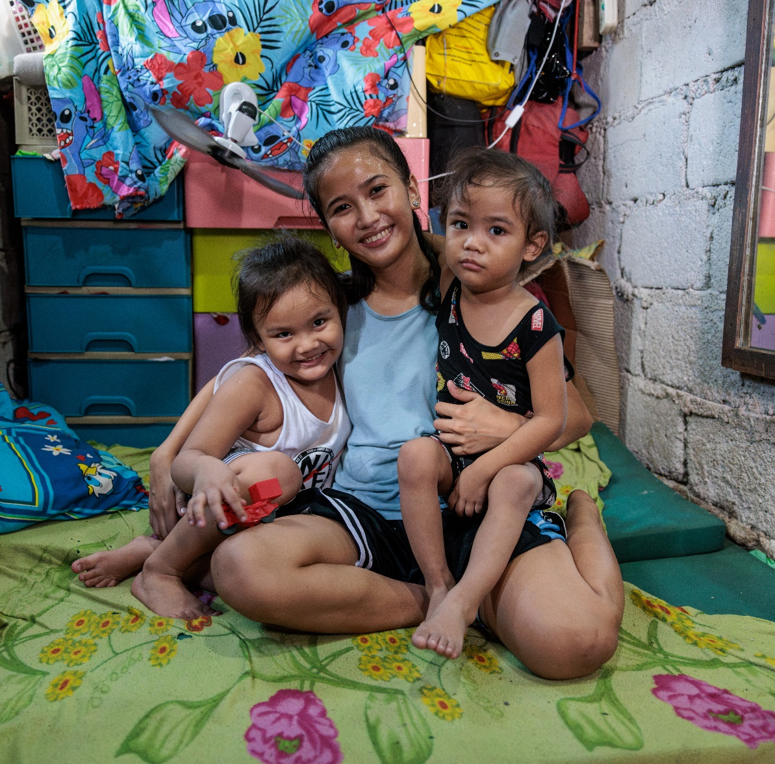
CST – Primary
Preferential Option for the Poor
Foundation to Year 2
Inquiry Questions:
What is poverty?
Does everyone have what they need?
Ronita smiles as she holds her sons in their small home in Quezon City, Philippines. Photo: Richard Wainwright/Caritas Australia

Slide 2
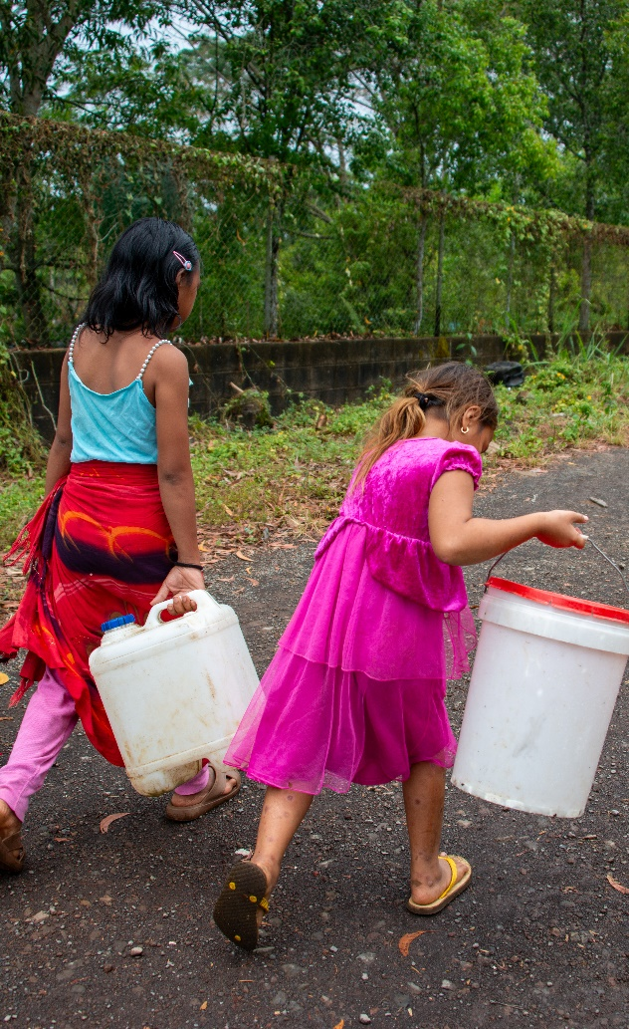
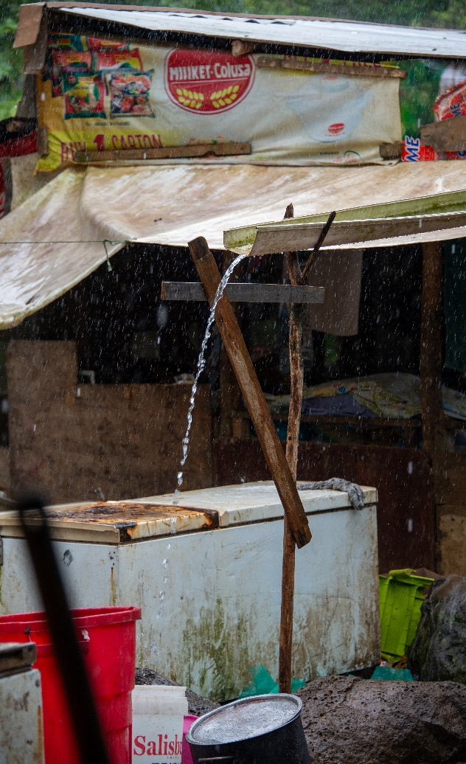
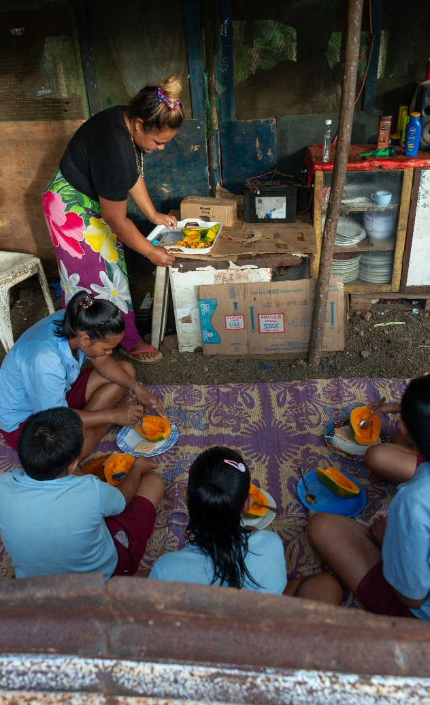
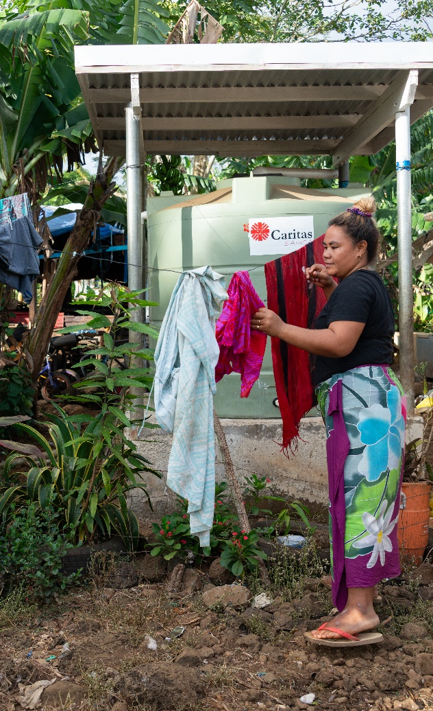
Leaia’s Story – See Think Wonder
Photo: Caritas Australia
Notes:
Photo captions L-R: Leaia’s children walking to collect clean water from the neighbour down the road, Make-shift roof and piping to collect rainwater in old fridges and buckets, Leaia preparing breakfast for her children before the walk to school, Leaia hanging out washing after being able to use clean water from the recently installed water tank.

Slide 3
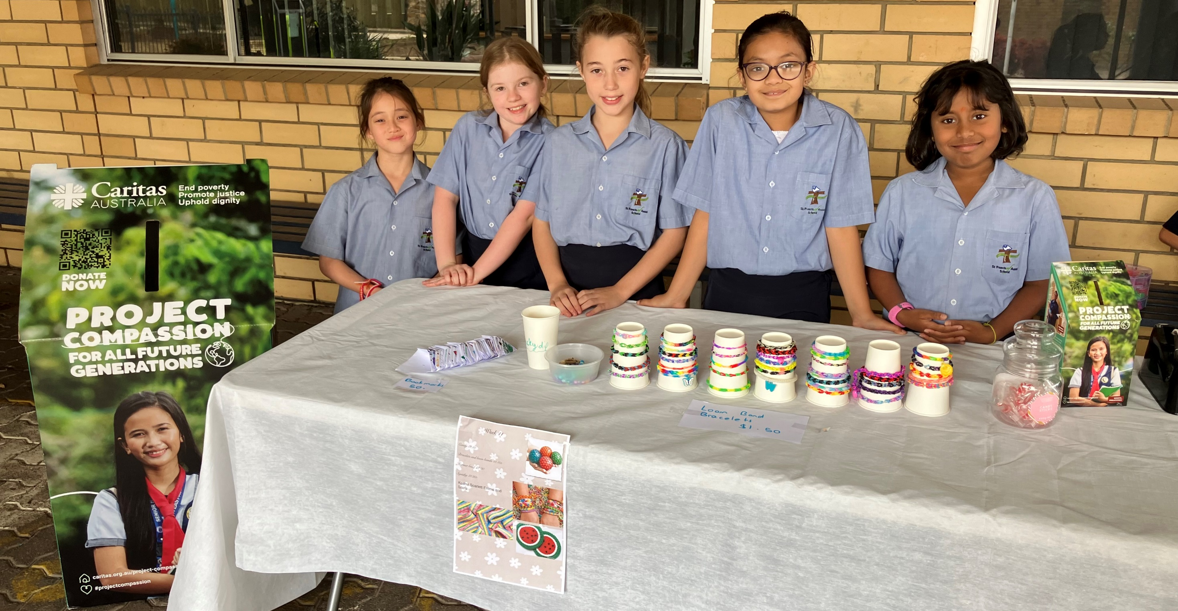
‘It is an act of charity to assist someone suffering, but it is also an act of charity, even if we do not know that person, to work to change the social conditions that caused his or her suffering.’
Pope Francis, Fratelli Tutti n186
Photo: St Francis of Assis, Newton
Notes:
Year 6 Social Justice leaders ran various stalls to be able to fundraise for Project Compassion, 2024.

Slide 4
Prayer
Dear God,
We, here in (insert class name), thank you for helping us to understand that some people don’t have what they need, like healthy food to eat, clean water to drink or a home to live in. Encourage us to share our learning with others. We pray for people living in poverty. We ask that you guide us to do what we can to help others in need.
Amen.

