Slide 1
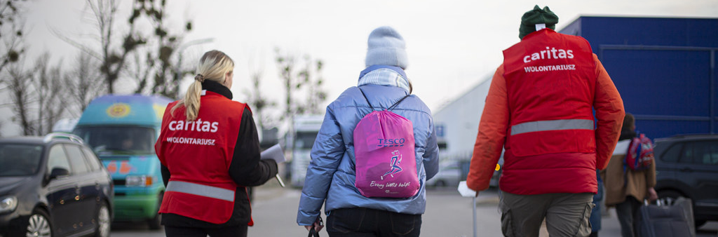
CST: Solidarity
Middle primary: Years 3 and 4
What is solidarity?
Photo: Philipp Spalek
Notes:
Caritas Poland supporting refugees coming from Urkaine in Prezemysl, Poland.

Slide 2
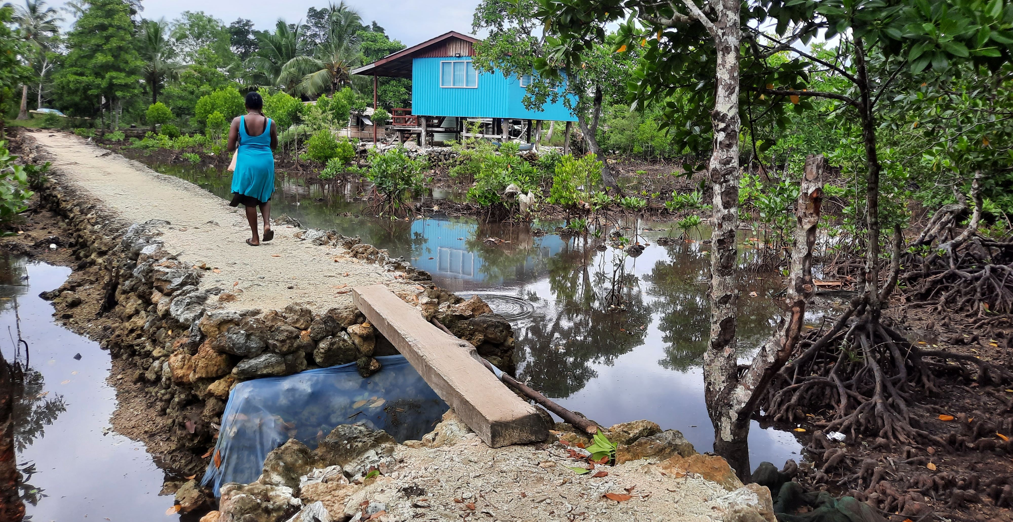
Photo: Caritas Australia
Notes:
Photo: This community in Solomon Island’s has raised different roads, footpaths and homes in the community due to rising sea levels. Now community members can access the local market, clinic and the local school.
Teacher Notes:
The community is working to building up the roads to align with a concrete bridge in the community. This bridge was built to help people who are living with a disability to escape during a disaster e.g. Tsunami’s. To build up the surfaces, community members dig up the drains first, then use the mud and stones to build up the road. This involves everyone, children, elderly, the sick; the community needs to work together to be able to survive.
When the sea comes in, the road leading to the school is covered, making it difficult for trucks to access. Children and sick people would use coconut trunks and/or big stones to be able to walk across to be able to access schools and medical clinic.

