Slide 1
Information for teachers
This PowerPoint highlights the key issues of urban poverty for secondary school students. It is intended as a flexible teaching tool for teacher use.
There are suggested discussion questions, tasks and additional information in the ‘Notes’ sections of the slides. There is also a suggested learning task at the end, which can be printed and distributed as a group activity.
It is our hope that you will use these slides in a way that best suits your purposes. As such, the slides are editable so that the content is flexible for you to adapt to your needs. If you do edit this presentation, please ensure content and photos from this resource remain with the appropriate credit to Caritas Australia and the photographers.
Your feedback on resources is always welcome. Please email education@caritas.org.au. For more resources visit www.caritas.org.au/schools

Slide 2
Urban poverty Secondary curriculum links:
Geography
Year 7: Unit 2, Place and liveability. The factors that influence the decisions people make about where to live and their perceptions of the liveability of places (ACHGK043). The influence of accessibility to services and facilities on the liveability of places (ACHGK044). The influence of social connectedness and community identity on the liveability of place (ACHGK046). Year 8: Unit 2, Changing nations. The causes and consequences of urbanisation, drawing on a study from Indonesia, or another country of the Asia region (ACHGK054).
Year 10: Unit 2, Geographies of human wellbeing. Different ways of measuring and mapping human wellbeing and development, and how these can be applied to measure differences between places (ACHGK076). Reasons for spatial variations between countries in selected indicators of human wellbeing (ACHGK077). Issues affecting development of places and their impact on human wellbeing, drawing on a study from a developing country or region in Africa, South America or the Pacific Islands (ACHGK078). The role of international and national government and non-government organisations' initiatives in improving human wellbeing in Australia and other countries (ACHGK081).
Unit 2: Sustainable Places ACHGE039, ACHGE045, ACHGE050-053.
Also see ‘Urbanisation: One City-two ways of seeing: Sao Paulo, Brazil’ resource pack, suitable for Senior Geography.

Slide 3
Urban Poverty

Slide 4
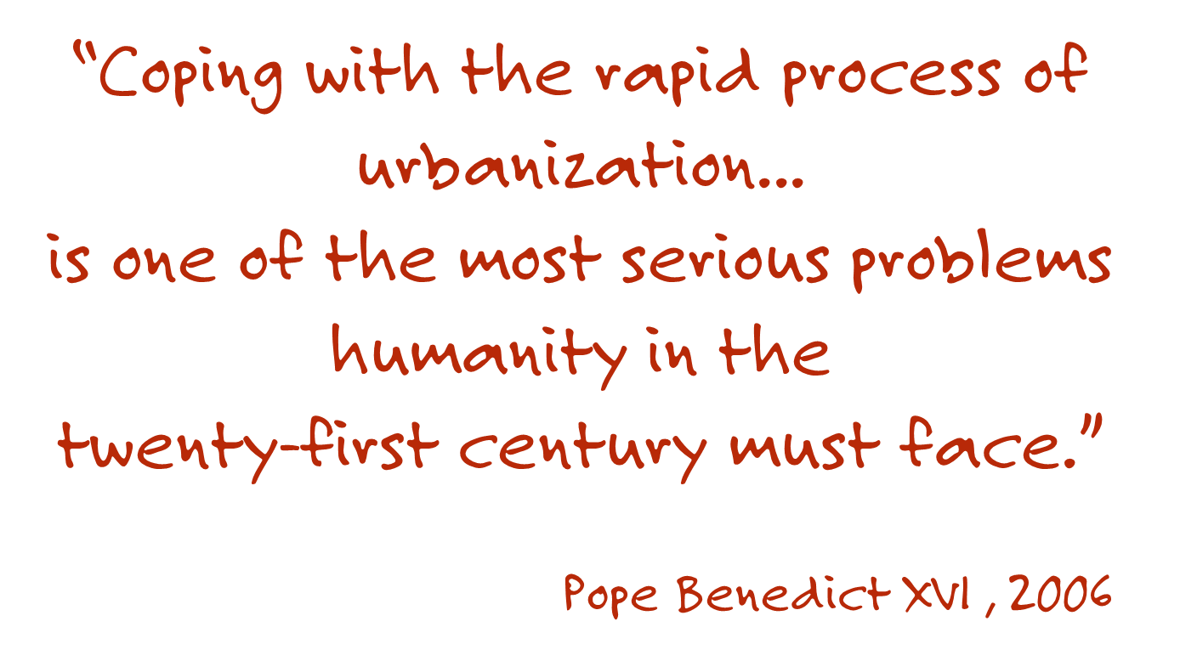

Slide 5
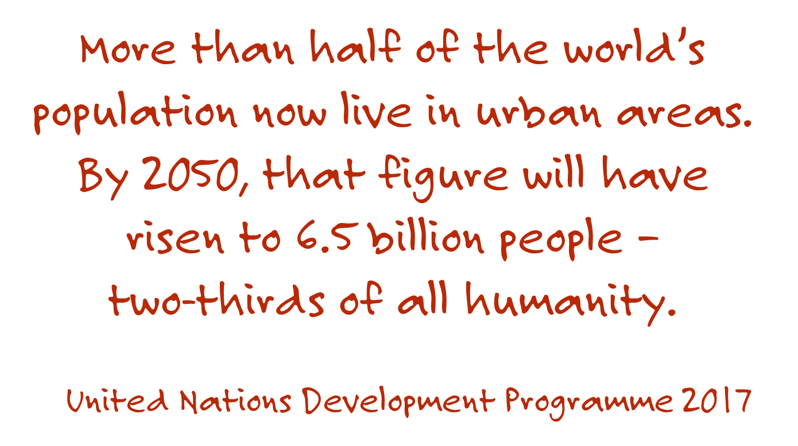

Slide 6
Facts and figures
Half of humanity – 3.5 billion people – live in cities today.
By 2030, almost 60 per cent of the world’s population will live in urban areas.
95 per cent of urban expansion in the next decades will take place in developing nations.
Source: globalgoals.org
Notes:
Discuss:
What questions do you have about these statistics? Do any of them surprise you? Why/Why not?
What are the implications of almost 60% of the world’s population living in urban areas?

Slide 7
Facts and figures
828 million people live in slums today and the number keeps rising.
The world’s cities occupy just 3 per cent of the Earth’s land, but account for 60-80 percent of energy consumption and 75 per cent of carbon emissions.
Source: globalgoals.org
Notes:
Discuss:
What questions do you have about these statistics? Do they surprise you? Why/Why not.
What is a slum?

Slide 8
Urbanisation
The Organisation for Economic Co-operation and Development (OECD) defines ‘urbanization’ as:
1. increase in the proportion of a population living in urban areas;
2. process by which a large number of people becomes permanently concentrated in relatively small areas, forming cities.
Urbanisation is considered a global phenomenon, with varying impacts on different countries.
Notes:
Discuss: How is a global phenomena defined?

Slide 9
MEGA CITIES
The rapid growth of cities in the developing world, coupled with increasing urban migration, has led to a boom in mega-cities.
A mega-city is a city with 10 million or more inhabitants.
In 1990, there were ten mega-cities. In 2017, there are 37 mega-cities, home to a total 453 million people.
Photo credit: NASA Goddard Space Flight Centre/Flickr

Slide 10
TRENDS
Explore Interactive Data about Urban and Rural Population.
Compare the Average Annual Rate of Change of the Urban population (%) between high-income and low-income countries.
What trend do you notice?
In groups, select different combinations of indicators and report your observations back to the group.

Slide 11
URBAN POVERTY
Why do you think people move to towns and cities?
More employment opportunities.
Better education and healthcare.
Higher living standards.
What might be some of the challenges of dense and informal urban living for young people?
Bangladesh. Photo credit: Caritas Australia

Slide 12
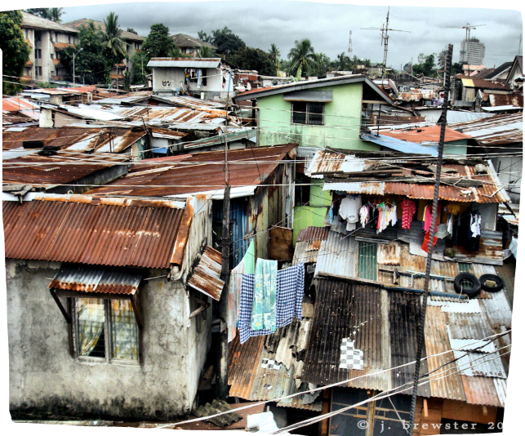
Urban poverty
The 21st century urban landscape is closely linked to:
Exclusion,
rising inequality,
the upsurge in international migration,
challenges in providing urban services,
safety and security issues,
climate change,
lack of access to safe water and sanitation,
insecure home ownership
increasing residency in slums and informal settlements.
Photo credit: viewfinderview/Flickr
Notes:
Discuss: What might be some of the other challenges or negative impacts of increased urbanisation?
What is the impact on human wellbeing?

Slide 13
Urban poverty: slums
The United Nations characterise slums or ‘informal settlements’ as lacking one or more of the following five conditions:
access to improved water,
access to improved sanitation facilities,
sufficient living area – not overcrowded,
structural quality/durability of dwellings, and
security of tenure.
A dwelling, in an informal settlement in Fiji. Families, children and communities may face more illness and struggle living in conditions without water services and sanitation. Photo credit: Richard Wainwright
Notes:
Discuss: What do you know about slums? What are some of the words/concepts/examples that come to mind when you think about urban slums?
What impact does living in a slum have on human health, education and employment?
Source: https://unhabitat.org/wp-content/uploads/2015/04/Habitat-III-Issue-Paper-22_Informal-Settlements-2.0.pdf

Slide 14
MEASURING WELLBEING
Information about the poverty that exists in countries is often measured financially; living on less than $1.90 a day is considered ‘extreme poverty’. This was set by the World Bank and is used widely.
Another widely used measure to talk about the status of a country is the Gross Domestic Product (GDP). This measures the monetary value of all the goods and services produced in a country or region.
What are the limitations in measuring poverty and progress in financial terms?
What else is poverty about?
List at 5 or more indicators that you think should be considered when discussing human wellbeing.
Notes:
For further

Slide 15
MEASURING WELLBEING
The Human Development Indicators consider more than economic status- they aim to collate data that gives a picture about human wellbeing.
The dimensions are in two categories: dimensions that enhance human capabilities (knowledge, long and healthy life, decent standard of living) and dimensions that create the conditions for human development (participation in political and economic life, environmental sustainability, human security and rights, promoting equity and social justice).
What are the strengths and weaknesses of this approach to measuring wellbeing?
What other dimensions could be added?
Explore the Interactive Data about International Human Development Indicators.
Find and Compare Australia with two countries from the Asia region.
What differences and similarities do you notice? What surprises you and why?
Notes:
For further

Slide 16
urbanisation can be positive
It can lead to a thriving economy, strong social organizations and technological innovation while reducing resource and energy consumption.
What strategies can be used to mitigate the challenges raised by rapid urbanisation?

Slide 17
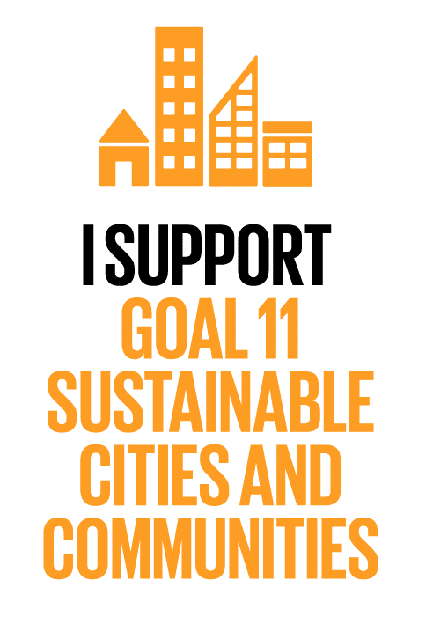
Sustainable Development Goals
The Sustainable Development Goals are a set of 16 goals for all people, everywhere. They aim to end extreme poverty, inequality and climate change by 2030.
Goal 11 aims to make cities and human settlements inclusive and resilient. Access to safe and affordable housing and upgrading slum settlements are key aspects of this goal.
In what ways are slums or informal settlements unsustainable? How does your city ensure access to safe and affordable housing?

Slide 18
Sustainable Development Goals
Global Goal 11 also involves investment in:
public transport,
creating green public spaces,
improving urban planning and management in a way that is both participatory and inclusive.
In what ways is your city safe and sustainable?
What public transport, public green space, and inclusive urban planning initiatives are you aware of?
Favelas are often built on land that no one wants to live on due to threats of floods, landslides or their proximity to roads and train lines. Photo credit: Erin Johnson
Notes:
Discuss: Why is it important for planning to be participatory and inclusive?

Slide 19
CARITAS AUSTRALIA TACKLES URBAN POVERTY
Caritas Australia is committed to working with the most vulnerable to help them end poverty, promote justice and uphold their dignity.
This includes supporting partners who work with people experiencing poverty in urban or informal settlements. Together they identify, discuss and address the challenges they face. We believe in every person’s right to participate in the decisions that affect their lives, and that people can be the architect of change in their communities.
Explore the following case studies.
Find the Human Development Index ranking for Fiji, Brazil, Cambodia and Australia.
Identify and compare the strategies used to empower people experiencing poverty in marginalized urban communities in Fiji, Brazil and Cambodia.
Summarise the issues Caritas Australia and their partner’s address in each city?
Describe how these strategies enhance the liveability of these places?

Slide 20
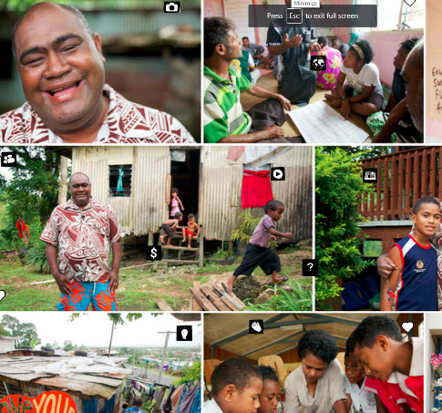
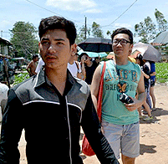
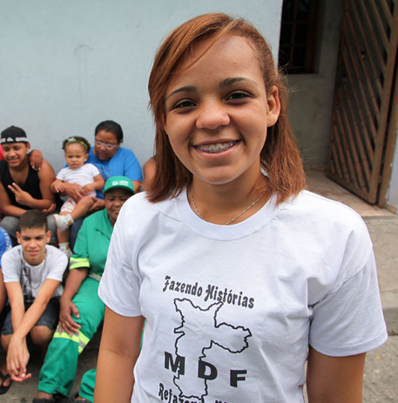
Urbanisation case studies
Semiti in Fiji
Vannak in Cambodia
Maristely in Brazil
Click the links to access stories of people who have experienced urban poverty and have participated in Caritas Australia supported
programs.
Semiti in Fiji
Vannak in Cambodia
Maristely in Brazil
The content in the links includes films, photos and further information.
Notes:
Alternatively the plain text of each story has been provided at the end of this PowerPoint (from slide 34).

Slide 21
ACT: SUPPORT AUSTRALIAN AID
Australian aid has helped millions of people across the world to break down the barriers that held them in a cycle of poverty, including the negative impacts of rapid urbanisation.
Since 2014, the government has cut the Australian aid program by a staggering $11.3 billion over four years. These cuts are devastating for people in the world’s most vulnerable communities and take Australian aid to its lowest level in six decades. We are now one of the least equitable contributors amongst the OECD countries.
Join Caritas Australia and a movement of people who want the proud tradition of Australian aid to continue. When Australia is a compassionate global citizen, it reflects our sense of fairness, justice and compassion that are at the heart of our collective well-being.
Support the ‘Campaign for Australian Aid’

Slide 22
LEARNING TASK SUGGESTION Distribute the following extracts and quotes for small group discussion.
Notes:
Thinking tool: ‘Connect, Extend Challenge’

Slide 23
REFLECT AND RESPOND Consider what you have learnt so far and the stories you have heard. What stands out to you most? Why? In small groups, read the following quotes and extracts from Pope Francis’ encyclical ‘Laudato Si’ and other sources to help you form your responses. What impact does urbanisation have on human wellbeing? What do you see as important for better cities in the future? What role does and can Australia play in this issue?
Notes:
Use this thinking tool:
CONNECT: How are the ideas and information presented CONNECTED to what you already knew? EXTEND: What new ideas did you get that EXTENDED or pushed your thinking in new directions? CHALLENGE: What is still CHALLENGING or confusing for you to get your mind around? What questions, wonderings or puzzles do you now have?

Slide 24
#44 “Nowadays, for example, we are conscious of the disproportionate and unruly growth of many cities, which have become unhealthy to live in, not only because of pollution caused by toxic emissions but also as a result of urban chaos, poor transportation, and visual pollution and noise. Many cities are huge, inefficient structures, excessively wasteful of energy and water. Neighbourhoods, even those recently built, are congested, chaotic and lacking in sufficient green space. We were not meant to be inundated by cement, asphalt, glass and metal, and deprived of physical contact with nature.” Pope Francis, Laudato Si’.
Notes:
Discuss: Where do you see what Pope Francis has described? What images or situations does it bring to mind?
What does this mean for you? Think about your own city.
Use this thinking tool:
CONNECT: How are the ideas and information presented CONNECTED to what you already knew? EXTEND: What new ideas did you get that EXTENDED or pushed your thinking in new directions? CHALLENGE: What is still CHALLENGING or confusing for you to get your mind around? What questions, wonderings or puzzles do you now have?

Slide 25
#45 “In some places, rural and urban alike, the privatization of certain spaces has restricted people’s access to places of particular beauty. In others, “ecological” neighbourhoods have been created which are closed to outsiders in order to ensure an artificial tranquillity. Frequently, we find beautiful and carefully manicured green spaces in so-called “safer” areas of cities, but not in the more hidden areas where the disposable of society live.” Pope Francis, Laudato Si’.
Notes:
Discuss: Where do you see what Pope Francis has described? What images or situations does it bring to mind?
What does this mean for you? Think about your own city.
Use this thinking tool:
CONNECT: How are the ideas and information presented CONNECTED to what you already knew? EXTEND: What new ideas did you get that EXTENDED or pushed your thinking in new directions? CHALLENGE: What is still CHALLENGING or confusing for you to get your mind around? What questions, wonderings or puzzles do you now have?

Slide 26
#49. “It needs to be said that, generally speaking, there is little in the way of clear awareness of problems which especially affect the excluded. Yet they are the majority of the planet’s population, billions of people. These days, they are mentioned in international political and economic discussions, but one often has the impression that their problems are brought up as an afterthought, a question which gets added almost out of duty or in a tangential way, if not treated merely as collateral damage. Indeed, when all is said and done, they frequently remain at the bottom of the pile.” Pope Francis, Laudato Si’.
Notes:
Discuss: Where do you see what Pope Francis has described? What images or situations does it bring to mind?
What does this mean for you? Think about your own city.
Use this thinking tool:
CONNECT: How are the ideas and information presented CONNECTED to what you already knew? EXTEND: What new ideas did you get that EXTENDED or pushed your thinking in new directions? CHALLENGE: What is still CHALLENGING or confusing for you to get your mind around? What questions, wonderings or puzzles do you now have?

Slide 27
#49. “This is due partly to the fact that many professionals, opinion makers, communications media and centres of power, being located in affluent urban areas, are far removed from the poor, with little direct contact with their problems. They live and reason from the comfortable position of a high level of development and a quality of life well beyond the reach of the majority of the world’s population.” Pope Francis, Laudato Si’.
Notes:
Discuss: Where do you see what Pope Francis has described? What images or situations does it bring to mind?
What does this mean for you? Think about your own city.
Use this thinking tool:
CONNECT: How are the ideas and information presented CONNECTED to what you already knew? EXTEND: What new ideas did you get that EXTENDED or pushed your thinking in new directions? CHALLENGE: What is still CHALLENGING or confusing for you to get your mind around? What questions, wonderings or puzzles do you now have?

Slide 28
#49. “This lack of physical contact and encounter, encouraged at times by the disintegration of our cities, can lead to a numbing of conscience and to tendentious analyses which neglect parts of reality. Today, however, we have to realize that a true ecological approach always becomes a social approach; it must integrate questions of justice in debates on the environment, so as to hear both the cry of the earth and the cry of the poor.” Pope Francis, Laudato Si’.
Notes:
Discuss: Where do you see what Pope Francis has described? What images or situations does it bring to mind?
What does this mean for you? Think about your own city.
Use this thinking tool:
CONNECT: How are the ideas and information presented CONNECTED to what you already knew? EXTEND: What new ideas did you get that EXTENDED or pushed your thinking in new directions? CHALLENGE: What is still CHALLENGING or confusing for you to get your mind around? What questions, wonderings or puzzles do you now have?

Slide 29
#150. “More precious still is the service we offer to another kind of beauty: people’s quality of life, their adaptation to the environment, encounter and mutual assistance. Here too, we see how important it is that urban planning always take into consideration the views of those who will live in these areas.” Pope Francis, Laudato Si’.
Notes:
Discuss: Where do you see what Pope Francis has described? What images or situations does it bring to mind?
What does this mean for you? Think about your own city.
What do you think would improve your city?
Use this thinking tool:
CONNECT: How are the ideas and information presented CONNECTED to what you already knew? EXTEND: What new ideas did you get that EXTENDED or pushed your thinking in new directions? CHALLENGE: What is still CHALLENGING or confusing for you to get your mind around? What questions, wonderings or puzzles do you now have?
http://www.visiblethinkingpz.org/VisibleThinking_html_files/03_ThinkingRoutines/03d_UnderstandingRoutines/ConnectExtendChallenge/ConnectExtend_Routine.html

Slide 30
Human Rights: The Universal declaration of Human Rights (UDHR)
Article 25:
Everyone has the right to a standard of living adequate for the health and well-being of himself and of his family, including food, clothing, housing and medical care and necessary social services, and the right to security in the event of unemployment, sickness, disability, widowhood, old age or other lack of livelihood in circumstances beyond his control.
Notes:
The Universal Declaration on Human Rights (the Universal Declaration) was adopted by the United Nations (UN) General Assembly in 1948. Australia was a founding member of the UN and played a prominent role in the negotiation of the UN Charter in 1945. Australia was also one of eight nations involved in drafting the Universal Declaration.
Discuss:
Where do you see these needs not being met?
Are these obligations being met for all Australians?
Use this thinking tool:
CONNECT: How are the ideas and information presented CONNECTED to what you already knew? EXTEND: What new ideas did you get that EXTENDED or pushed your thinking in new directions? CHALLENGE: What is still CHALLENGING or confusing for you to get your mind around? What questions, wonderings or puzzles do you now have?

Slide 31
Human rights: International Covenant on Economic, Social and Cultural Rights
Article 11
1. The states parties to the present covenant recognise the right of everyone to an adequate standard of living for himself and his family, including adequate food, clothing and housing, and to the continuous improvement of living conditions. The states parties will take appropriate steps to ensure the realization of this right, recognising to this effect the essential importance of international co-operation based on free consent.
Notes:
Adopted and opened for signature, ratification and accession by General Assembly resolution 2200A (XXI) of 16 December 1966 entry into force 3 January 1976, in accordance with article 27
Discuss:
Where do you see these needs not being met?
Are these obligations being met for all Australians?
Use this thinking tool:
CONNECT: How are the ideas and information presented CONNECTED to what you already knew? EXTEND: What new ideas did you get that EXTENDED or pushed your thinking in new directions? CHALLENGE: What is still CHALLENGING or confusing for you to get your mind around? What questions, wonderings or puzzles do you now have?
Source: http://www.ohchr.org/EN/ProfessionalInterest/Pages/CESCR.aspx

Slide 32
HUMAN DIGNITY
THE COMMON GOOD
Every person is created in God’s image. All human life is sacred.
We believe in the dignity of each person.
We believe in working towards the common good and looking beyond our own personal interests.
We believe
PREFERENTIAL OPTION FOR THE POOR
ECONOMIC
JUSTICE
STEWARDSHIP OF CREATION
Everyone has the right to access the means to support themselves and their family.
Stewardship of the Earth’s resources is vital for the common good of people.
Prioritising women, men and children most vulnerable to extreme poverty and injustice.
SOLIDARITY
SUBSIDIARITY
PARTICIPATION
We are part of one human family. We have a responsibility to help each person achieve their full potential.
Every person has a right to participate in the decisions that affect their own lives.
Every person can be the architect of change in their own life.
caritas.org.au
Notes:
Discuss: Which principle stands out to most in relation to the issues of urbanisation? Why?
Use this thinking tool:
CONNECT: How are the ideas and information presented CONNECTED to what you already knew? EXTEND: What new ideas did you get that EXTENDED or pushed your thinking in new directions? CHALLENGE: What is still CHALLENGING or confusing for you to get your mind around? What questions, wonderings or puzzles do you now have?

Slide 34
Appendix: Case studies in Plain text for easier distribution

Slide 35
Semiti’s story- FIJI
Rich in natural resources, Fiji is one of the most developed Pacific Island nations. Yet many Fijians still live in poverty, and the country experiences serious political and social tensions. 6 per cent of the population lives on less than $1.25 a day.
More than a quarter of the population lives in informal settlements. People living in informal settlements in Fiji have no access to the most basic of rights – land tenure, housing, sanitation, roads, education, and a secure livelihood
Across Fiji, Caritas Australia’s partner the People’s Community Network (PCN) empowers people living in informal settlements around Fiji. Supported by Caritas Australia since 2009, PCN brings together people from informal settlements, enabling them to advocate to improve their access to education, housing and employment.
Here we share the voices of PCN community members, whose lives have been transformed by neighbourly love. Their voices are linked in powerful chorus through a countrywide network, the people’s community network (PCN). Semiti, the national director of the PCN, grew up in an informal settlement.
SEMITI: One thing that my past taught me is to give back to the community what I have learned. And to try and lift them up from their impoverished situation. I always tell them: I was once in your shoes. I was once a squatter, like you. I was once someone who had nothing. People in informal settlements have been living there for quite some time. So they start to believe that they are nobody, that they have no rights. Our main role is to empower them so that they can believe in themselves, and move out of that situation.
SAVU (PCN’s Assistant Director): Our first work in settlements is to carry out workshops [on] community empowerment, social analysis and economic literacy. These three workshops are the big changers. They change mindset – they change relationships, and build relationships for people to become change agents in their communities.
Page 1 of 2

Slide 36
Semiti’s story- FIJI
The program develops the understanding of shared goals by community members, and empowers community members to advocate for their rights as citizens to housing, education, and a secure future.
SAVU: We journey together with the people in saying that a new world [is] possible … where families have access to new housing, to land security, to better education. Committees have been formed in each settlement to deal with many issues – health and hygiene; care of the elderly; activities for women, particularly those not working; education; and employment, to enhance the skills of young people. PCN has also established savings groups across Fiji, with women in leadership roles. These groups encourage people in the community to make weekly savings so they can access education, healthcare and housing.
VANI: education is the most important thing in our life, because that is our future. PCN offers informal settlements, a well resourced educational environment for children. Children who were working are now back at school. Unemployed young men and women can undertake training, and there are homework centres where children from surrounding settlements can use computers or get help from the teachers or other students. Through PCN, marginalised voices are now raised in hope:
TEVITA: PCN is not only about housing. It’s not only about money. In talking about saving, they taught us to save your relationship, to save health, education, and look after your senior citizens. PCN is like a raft that was thrown to us in the waves. They gave us hope that there was still life within if we stand together and hold each other’s hand and move together forward.
Caritas Australia is proud to support this network of communities as they work in solidarity and grow in resilience.
Page 2 of 2

Slide 37
MARISTELY’S story- BRAZIL
Brazil is the fifth most populous country in the world. Over the past decade, the country has undergone strong economic growth, and at 2013 is the largest economy in Latin America. With an abundance of natural resources, much of its economic growth has been through agricultural, mining and manufacturing industries.
Yet not all people have benefited from Brazil's economic growth. Substantial income inequalities existing in the country. The poorest 10 percent of Brazil’s population earn just 0.8% of the country’s income (World Bank, 2009). One in seventeen people in Brazil live on less than $US1.25 a day.
Unequal wealth distribution and substantial urban migration has led to a growth in favelas (shantytowns) in the larger cities of Brazil. Drug trafficking and gang-related violence are major problems in these poorer areas. Favela residents – particularly young people – are often marginalised and experience discrimination from the wider community.
Maristely, 18, lives in a favela (city slum) in São Paulo, Brazil. Caritas Australia’s partner Movement for the Defence of Favela Residents is working to improve living conditions within her community and other favelas in the city.
Dark and cramped, favelas are groups of irregular, self-constructed houses often built on land that no one wants to live on due to threats of floods, landslides, or their proximity to roads and train lines. Many locals face daily discrimination from the wider community.
When Maristely was growing up, her family’s house, like many others, was made of cardboard and had no electricity, water or connected sewerage.
Young favela leaders and Caritas Australia’s partner, the Movement for the Defence of Favela Residents (MDF), is working to change lives across 40 favelas in São Paulo. MDF understands the difficulties of favela life such as dense population, limited space, a lack of available jobs, constant threat of eviction and widespread poverty.
Page 1 of 1

Slide 38
MARISTELY’S story- BRAZIL
Through MDF, Maristely’s family, along with thousands of others, now has access to clean water, electricity and connected sewerage. They also have a certificate of home ownership which provides greater security and means they can no longer be evicted.
This program aims to address social and political issues through community participation and empowerment. MDF offers legal education and support to communities to obtain land titles and land ownership. It also works to provide access to clean water, sanitation, and important infrastructure such as community and childcare centres.
MDF encourages representation and participation by shanty town dwellers in municipal and state governments. It offers capacity building initiatives such as adult literacy and leadership programs to achieve this aim.
As part of the program, the Centro de Culturas runs art programs in the favelas, where young people can channel their passion and creativity into meaningful outcomes. Mentoring is an important part of the program and the young people develop a sense of dignity, self-worth, self-respect and respect for others. The art workshops give young people a chance to develop skills and contribute to the wellbeing of the entire community.
In 2011, MDF introduced a pilot module to the program that uses multimedia as a tool for countering the culture of drugs and violence of the favelas.
Maristely featured in Project Compassion 2014. In 2016, Maristely continues to be a committed advocate for human rights. She is in the final year of her Cultural Events course at university. She continues to participate in MDF more specifically at the monthly meetings and in the training for new leaders for favela residents. She is a member of her local parish Council.
Page 2 of 2

Slide 39
VANNAK’S story- CAMBODIA
Cambodia is still recovering from the Khmer Rouge’s brief but destructive reign between 1975 and 1979. Somewhere between 1 and 3 million people - one in four Cambodians - were killed under the regime, and the country’s economy and social structures were devastated. 70% of the population (15,677,100) live on less than $3 a day.
Vannak, 19, and his family live in Andong Village, the largest slum in Cambodia. Home to approximately 8,000 people, Andong was established in 2006 when the inhabitants were driven from their homes to make way for development.
The youth living in Andong face a myriad of everyday problems, including a lack of nutritious food, healthcare, adequate shelter and financial resources to attend school. As a result, there are high rates of unemployment, substance abuse, gang activities and violence. Furthermore, the youth are often viewed with distrust and experience discrimination from other community members.
When he was 15, Vannak left school to support his family. Around the same time, in the hopes of achieving a better life, his parents had borrowed money. So every week he would give most of his 12,000 Riels (US$3) a day earnings to them.
Although he was helping his family, Vannak felt a sense of hopelessness and knew that he could end up in a youth gang, passing time by drinking alcohol and gambling.
“Adults thought I was useless ... However they sometimes praised me as a good boy because I was helping my parents to pay off their debt.”
When he heard about the Youth Empowerment Project (YEP), which is run by Caritas Australia partner, Youth for Peace, Vannak decided to give it a go. Designed to provide life skills and vocational training such as handicrafts, gardening and small business, the goal of YEP is to increase youth employment, as well as build a sense of responsibility and solidarity.
Page 1 of 2

Slide 40
VANNAK’S story- CAMBODIA
The Youth Empowerment Project supported by Caritas Australia is based on the conviction that youth are the future of any country. The program therefore aims to help youth take actions towards reaching their personal goals, to take initiatives to work towards improving the situation in their families and communities, and also to improve cooperation between youth, their families and community leaders.
At first, Vannak wasn’t focused on learning; he was so hungry that what he most looked forward to was eating the food provided! However it didn’t take long for his hunger to grow for something else – learning; in particular silk screen printing and gardening.
Now 19 years old, Vannak, is in grade 12 at school. He's working hard as a student, earns an income, participates in peer counselling and is contributing to his community.
Vannak also enjoys giving back to his community.
“My parents and other villagers recognise that I am a new person … I offer advice to other youth and help the community to be aware of the importance of education, child protection, and hygiene,” he says.
With YFP’s support, Vannak’s family has improved their living conditions, plus they have paid off all their debt. They can now afford their basic needs, can pay for their children’s education and are expanding their small business.
“We are not in debt any more. My family has changed a lot. My two siblings and I are able to pursue our study. These are the results of initial support from Caritas Australia’s office in Cambodia – Australian Catholic Relief, Caritas Australia and Youth for Peace.”
Page 2 of 2

