Slide 1
Teacher Information
This resource is intended as a source of information for teaching and learning about issues surrounding poverty across several curriculum areas and units.
Please refer to the ‘Notes’ section of this presentation for additional information and source references.
It is our hope that you will take part/all of these slides and use them in a way that best suits your purposes. As such, the slides are editable so that the content, case studies and tools included in this resource are flexible for teachers and students to use in classroom instruction, independent student research or presentations.
If you do edit this resource, please ensure content and photos from this resources remain with the appropriate credit to Caritas Australia and the photographers.
For more school resources, please visit: caritas.org.au/resources/school-resources/
Stay up to date with events and resources! Subscribe to Caritas Australia’s Education e-newsletter
Copyright Policy: Material within our resources come from a variety of sources and authors, including Caritas Australia staff, volunteers, overseas partners and news organisations. These resources and the information, names, images, pictures, logos are provided “as is”, without warranty. Any mistakes brought to the attention of Caritas Australia will be corrected as soon as possible. To review the full Caritas Australia Copyright Policy, please visit: Caritas Australia​​
Links to external sites: This site contains links to external web sites. Caritas Australia takes no responsibility for the content of such sites, nor do links to such sites imply endorsement of the views expressed therein. External links are provided for informational purposes only.
Updated August 2024

Slide 2
students
Learning about challenges to the health, wellbeing and safety of others and our earth can be hard. If you are feeling worried or upset about anything you have learnt about through this resource, make sure you talk to your teacher or trusted adult. They can share your concerns via our website.
Do you have an idea for how Caritas Australia can improve our school resources? We would love to hear it! Please email education@caritas.org.au

Slide 3
First Nations people are advised that this resource and external links may contain images, voices and names of people who have died.

Slide 4
Root Causes of Poverty
Notes:
Photo L – R: Mrs Lan* helping children living with disabilities join community-based classrooms in Vietnam due to the support provided in the Empowerment of People with Disabilities program. Photo: Caritas Australia
Priscilla and her grandsons eat their breakfast porridge at home in north-western Zimbabwe. Photo: Richard Wainwright/Caritas Australia
Janice poses for a picture with her daughters Henrietta (19) (left) and Tiffany (20) in the shop at Djilpin Arts in Beswick, Northern Territory, Australia. Photo: Richard Wainwright/Caritas Australia.

Slide 5
What Does Poverty Look Like?
Poverty is hunger.
Poverty is lack of shelter.
Poverty is being sick and not being able to see a doctor.
Poverty is not being able to go to a school.
Poverty is not having a job, is fear for the future, living one day at a time.
Poverty is losing a child to illness brought about by lack of clean water.
Poverty is powerlessness, lack of representation and freedom.
Notes:
Source: Adapted from Can Anyone Hear Us?: Voices of the Poor (World Bank Publication) Paperback – March 1, 2000.
By Deepa Narayan, Raj Patel, Kai Schafft, Anne Rademacher and Sara Koch-Schulte.

Slide 6
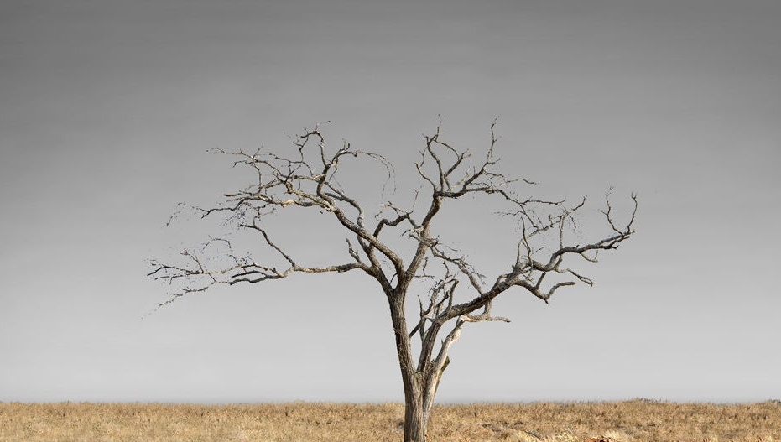
Let’s explore the issue of poverty…
Click each icon to learn more
After exploring all issues, click here to ‘dig deeper’

Slide 7
Hunger
One in 11 people
people do not have enough food to eat.
Priscilla and her grandsons eat their breakfast porridge at home in north-western Zimbabwe. Photo: Richard Wainwright/Caritas Australia
Notes:
Source: https://www.who.int/publications/m/item/the-state-of-food-security-and-nutrition-in-the-world-2024

Slide 8
Economics
700 million
people around the world live in extreme poverty on less than $2.15 per day.
Janice poses for a picture with her daughters in the shop at Djilpin Arts, Northern Territory, Australia. Richard Wainwright/Caritas Australia
Notes:
Source: World Bank Poverty Overview https://www.worldbank.org/en/topic/poverty/overview

Slide 9
Water Access
2.2 billion
people do not have access to safely managed drinking water.
Women using the water tap after the water quality was tested in Bangladesh. Photo: Caritas Australia
Notes:
*Safely managed drinking water and sanitation services: Drinking water from sources located on premises, free from contamination and available when needed, and using hygienic toilets from which wastes are treated and disposed of safely.
Source: https://www.unwater.org/water-facts/wash-water-sanitation-and-hygiene

Slide 10
Age
333 million
children are living in poverty.
Northern Kenya are experiencing extreme drought after three failed rain seasons, therefore, causing shortage of water for people and their livestock. Photo: Thom Flint/CAFOD
Notes:
Source: https://www.worldbank.org/en/topic/poverty/publication/global-trends-in-child-monetary-poverty-according-to-international-poverty-lines

Slide 11
Sanitation
1.5 billion
people do not have access to a decent toilet.
Due to conflict between groups in Democratic Republic of Congo, there are thousands of displaced people who are experiencing a lack of shelter, food, essential non-food items, hygiene facilities and other basic equipment needed for security. Photo: Bitita Dany/Caritas Goma
Notes:
Source: Water Aid https://www.wateraid.org/au/why-wateraid/facts-and-statistics

Slide 12
Education
244 million
children are missing out on primary and secondary education.
Mrs Lan* helping children living with disabilities join community-based classrooms in Vietnam due to the support provided in the Empowerment of People with Disabilities program. Photo: Caritas Australia
Notes:
Source: https://ourworldindata.org/global-education?insight=hundreds-of-millions-of-children-worldwide-do-not-go-to-school#key-insights
*pseudonym used

Slide 13
Let’s dig deeper to find some of the root causes of poverty…

Slide 14
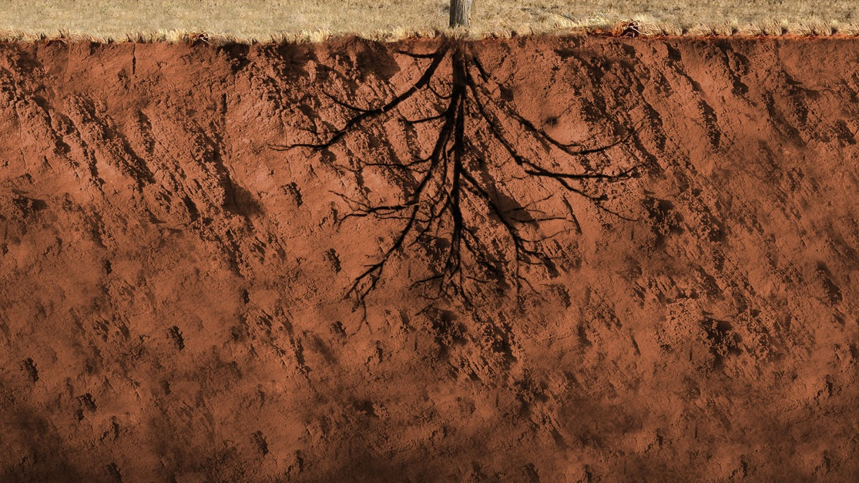
Click each icon to learn more
DEBT
FOOD INSECURITY
CONFLICT
ENVIRONMENTAL FACTORS
LACK OF EDUCATION
POOR HEALTH
GENDER INEQUALITY
FINISH

Slide 15
DEBT
Countries borrow money to pay for projects like roads, irrigation and agricultural projects, or to help them through difficult times such as a natural disaster.
Debt mounts up and repayments can eat into budgets for education, health and development programs. This can mean prices for essential services increase, making it harder for some people to afford them.
Notes:
Source:
CAFOD https://assets.ctfassets.net/vy3axnuecuwj/fa06e3e53c89b4489b0ad176a3620931376b6dbde31086ef68c8446192556184/c617eda08e9c42321dc0efa31161860e/Factsheet_Poverty_2018.pdf

Slide 16
Conflict
During conflict, family income earners may be called into military service, crops may be destroyed, water sources polluted, and livestock killed or stolen. This reduces family income for essential services, food security and water access.
Injury and disability, resulting from the conflict, can make it difficult for people to grow food, collect water or earn an income – even after a conflict stops.
Notes:
Source:
CAFOD https://assets.ctfassets.net/vy3axnuecuwj/bd9eeb59abe0b6c1f2e5735bddede0f885e21ac7d21f5c2f91815d56fbd46ee8/518382e9134d0d9740afdbefca396cea/Factsheet_Poverty_2018.pdf

Slide 17
Lack of Education
Children who cannot go to school will have fewer opportunities to escape poverty.
Contributing factors to lack of education include:
Lack of government funding
Cost of school supplies, uniforms and transportation
Untrained or poorly trained teachers
No classroom
Gender
Disabilities
Distance from home to school.
Notes:
Source:
CAFOD https://assets.ctfassets.net/vy3axnuecuwj/bd9eeb59abe0b6c1f2e5735bddede0f885e21ac7d21f5c2f91815d56fbd46ee8/518382e9134d0d9740afdbefca396cea/Factsheet_Poverty_2018.pdf
Global Citizen https://www.globalcitizen.org/en/content/10-barriers-to-education-around-the-world-2/
https://www.globalcitizen.org/en/content/poverty-education-satistics-facts/

Slide 18
Gender Inequities
Women and girls are more vulnerable to poverty than men and boys. Their basic rights are denied just because of their gender.
This means they often have less access to basic education and healthcare, have less opportunities to find jobs, are paid lower wages, suffer harm and, in some countries, can’t even own their own land.
Notes:
Source:
CAFOD https://assets.ctfassets.net/vy3axnuecuwj/bd9eeb59abe0b6c1f2e5735bddede0f885e21ac7d21f5c2f91815d56fbd46ee8/518382e9134d0d9740afdbefca396cea/Factsheet_Poverty_2018.pdf
UN Women https://www.unwomen.org/en/about-us/about-un-women

Slide 19
Poor Health
Poor health is a major cause of poverty. Seeking medical attention can be expensive. Doctors' visits, tests, medicines and transportation all need to be paid for.
Family income earners may have to take time off work or children may have to take time off school to care for the sick. Some families may need to sell belongings or go into debt to pay for medical costs.
For the first time in 20 years extreme poverty rates have risen as a result of the COVID-19 pandemic.
Notes:
Source:
World Bank https://www.worldbank.org/en/topic/health/brief/poverty-health
https://www.worldbank.org/en/topic/poverty/overview
https://assets.ctfassets.net/vy3axnuecuwj/bd9eeb59abe0b6c1f2e5735bddede0f885e21ac7d21f5c2f91815d56fbd46ee8/518382e9134d0d9740afdbefca396cea/Factsheet_Poverty_2018.pdf

Slide 20
Environmental factors
It is estimated that climate change will drive an estimated 130 million people into poverty by 2030.
Natural disasters, food insecurity, impacts of deforestation (cutting down forests) and loss of biodiversity (variety of plants and animals) are all contributing factors.
These environmental factors will affect poorest countries the most.
Notes:
Source: https://www.weforum.org/agenda/2023/01/climate-crisis-poor-davos2023/

Slide 21
Food Insecurity
Without access to safe, sufficient and nutritious food, people’s health can suffer. This can affect their ability to earn an income, attend school and lead a healthy and active life.
Children who are not able to eat properly for long periods of time may have incomplete physical development and can have learning difficulties.
Notes:
Sources:
CAFOD https://assets.ctfassets.net/vy3axnuecuwj/bd9eeb59abe0b6c1f2e5735bddede0f885e21ac7d21f5c2f91815d56fbd46ee8/518382e9134d0d9740afdbefca396cea/Factsheet_Poverty_2018.pdf
FAO http://www.fao.org/3/y4671e/y4671e06.htm#fnB31

